Slide 1
Basic Computer Organization and Design <number>
Overview
Instruction Codes
Computer Registers
Computer Instructions
Timing and Control
Instruction Cycle
Memory Reference Instructions
Input-Output and Interrupt
Complete Computer Description
CSE 211

Slide 2
Basic Computer Organization and Design <number>
Introduction
Organization of computer is defined by its :
  Internal Registers
  Timing and Control Structure
  Set of instructions that it uses
Every different processor type has its own design (different registers, buses, microoperations, machine instructions, etc)
Modern processor is a very complex device
It contains
  Many registers
  Multiple arithmetic units, for both integer and floating point calculations
  The ability to pipeline several consecutive instructions to speed execution
  Etc.
However, to understand how processors work, we will start with a simplified processor model
CSE 211

Slide 3
Basic Computer Organization and Design <number>
Basic Computer
The Basic Computer has two components, a processor and memory
The memory has 4096 words in it
  4096 = 2¹², so it takes 12 bits to select a word in memory
Each word is 16 bits long
CPU
RAM
0
4095
15
0
CSE 211

Slide 4
Basic Computer Organization and Design <number>
Instruction
Program
  A sequence of (machine) instructions
Instruction
  binary code that specifies a sequence of microoperations for a computer.
The instructions of a program, along with any needed data are stored in memory
The CPU reads the next instruction from memory
It is placed in an Instruction Register (IR)
Control circuitry in control unit then translates the instruction into the sequence of microoperations necessary to implement it
CSE 211

Slide 5
Basic Computer Organization and Design <number>
Instruction Format
Instruction Codes
  A group of bits that tell the computer to perform a specific operation (a sequence of micro-operation)
A computer instruction is often divided into two parts
  An opcode (Operation Code) that specifies the operation for that instruction
    Sometimes called as Macrooperation
  An address that specifies the registers and/or locations in memory to use for that operation
In the Basic Computer, the memory contains 4096 (= 2¹²) words, we needs 12 bit to specify which memory address this instruction will use
In the Basic Computer, bit 15 of the instruction specifies the addressing mode (0: direct addressing, 1: indirect addressing)
Since the memory words, and hence the instructions, are 16 bits long, that leaves 3 bits for the instruction’s opcode
CSE 211

Slide 6
Basic Computer Organization and Design <number>
Instruction Format
Sometimes the address bit of instruction code represent various different information, classified into different Instruction formats :
  Immediate Instruction : when second part of instruction specifies operand
  When second part of address specify address :
    Direct Addressing : second part of instruction specifies address of an operand
    Indirect Addressing : second part of instruction designates an address of a memory in which the address of the operand is found
Instruction Format
15
14
12
11
0
I
Opcode
Address
Addressing
mode
CSE 211

Slide 7
Basic Computer Organization and Design <number>
Addressing Mode
The address field of an instruction can represent either
  Direct address: the address in memory of the data to use (the address of the operand), or
  Indirect address: the address in memory of the address in memory of the data to use
Effective Address (EA)
  The address, that can be directly used without modification to access an operand for a computation-type instruction, or as the target address for a branch-type instruction
Direct addressing
Indirect addressing
22
0
ADD
457
35
1
ADD
300
300
1350
457
Operand
1350
Operand
+
+
AC
AC
CSE 211

Slide 8
Basic Computer Organization and Design <number>
Processor Register
A processor has many registers to hold instructions, addresses, data, etc
The processor has a register, the Program Counter (PC) that holds the memory address of the next instruction to be executed
  Since the memory in the Basic Computer only has 4096 locations, the PC only needs 12 bits
In a direct or indirect addressing, the processor needs to keep track of what locations in memory it is addressing: The Address Register (AR) is used for this
  The AR is a 12 bit register in the Basic Computer
When an operand is found, using either direct or indirect addressing, it is placed in the Data Register (DR). The processor then uses this value as data for its operation
The Basic Computer has a single general purpose register – the Accumulator (AC)
CSE 211

Slide 9
Basic Computer Organisation and Design <number>
Processor Register
The significance of a general purpose register is that it can be referred to in instructions
  e.g. load AC with the contents of a specific memory location; store the contents of AC into a specified memory location
Often a processor will need a scratch register to store intermediate results or other temporary data; in the Basic Computer this is the Temporary Register (TR)
The Basic Computer uses a very simple model of input/output (I/O) operations
  Input devices are considered to send 8 bits of character data to the processor
  The processor can send 8 bits of character data to output devices
The Input Register (INPR) holds an 8 bit character gotten from an input device
The Output Register (OUTR) holds an 8 bit character to be send to an output device
CSE 211

Slide 10
Basic Computer Organization and Design <number>
Processor Register
Registers in the Basic Computer
11
0
PC
Memory
11
0
4096 x 16
AR
15
0
IR
CPU
15
0
15
0
TR
DR
7
0
7
0
15
0
OUTR
INPR
AC
List of BC Registers
  DR 16 Data Register Holds memory operand
  AR 12 Address Register Holds address for memory
  AC 16 Accumulator Processor register
  IR 16 Instruction Register Holds instruction code
  PC 12 Program Counter Holds address of instruction
  TR 16 Temporary Register Holds temporary data
  INPR 8 Input Register Holds input character
  OUTR 8 Output Register Holds output character
CSE 211

Slide 11
Basic Computer Organization and Design <number>
Common Bus System
Basic computer : 8 register, a memory unit and a control unit
The registers in the Basic Computer are connected using a bus
This gives a savings in circuitry over complete connections between registers
Output of 7 register and memory connected to input of bus
Specific output that is selected for bus lines will be determined by selection variables S2, S1, S0
CSE 211

Slide 12
Basic Computer Organization and Design <number>
Common Bus System
S2
S1
Bus
S0
Memory unit
7
4096 x 16
Address
Write
Read
AR
1
LD INR CLR
PC
2
LD INR CLR
DR
3
LD INR CLR
E
ALU
AC
4
LD INR CLR
INPR
IR
5
LD
TR
6
LD INR CLR
OUTR
Clock
LD
CSE 211

Slide 13
Basic Computer Organization and Design
Common Bus System
Three control lines, S₂, S₁, and S₀ control which register the bus selects as its input
Either one of the registers will have its load signal activated, or the memory will have its write signal activated
  Will determine where the data from the bus gets loaded
Memory places its 16 bit output on bus when read input is activated and S2S1S0=111
S₂ S₁ S₀ Register
0 0 0 x
0 0 1 AR
0 1 0 PC
0 1 1 DR
1 0 0 AC
1 0 1 IR
1 1 0 TR
1 1 1 Memory
CSE 211

Slide 14
Basic Computer Organization and Design
Common Bus System
4 register DR, AC, IR, TR is 16 bit. The 12-bit registers, AR and PC, have 0’s loaded onto the bus in the high order 4 bit positions
When the 8-bit register OUTR is loaded from the bus, the data comes from the low order 8 bits on the bus
INPR – connected to provide information to bus
- receives character from input device and transfer to AC
OUTR – can only receive information from bus
- receives a character from AC and delivers to Output device
Three types of input to AC :
    from AC : complement AC, Shift AC
    from DR : arithmetic and logic microoperation
    from INPR
CSE 211

Slide 15
Basic Computer Organization and Design
Common Bus System
Bus lines connected to inputs of 6 registers and memory
Three types of input to AC :
    from AC : complement AC, Shift AC
    from DR : arithmetic and logic microoperation
    from INPR
Input/output data connected to common bus but memory address connected to AR
CSE 211

Slide 16

CSE211
Computer Organization and Design
Computer Instructions
Timing and Control
Instruction Cycles
Memory Reference Instructions
Input Output and Interrupts
Complete Computer Description

Slide 17
Basic Computer Organization and Design <number>
Overview
Instruction Codes
Computer Registers
Computer Instructions
Timing and Control
Instruction Cycle
Memory Reference Instructions
Input-Output and Interrupt
Complete Computer Description
CSE 211

Slide 18

Basic Computer Organization and Design <number>
Basic Computer Instructions
Basic Computer Instruction Format
1. Memory-Reference Instructions (OP-code = 000 ~ 110)
15 14
12 11
0
I
Opcode
Address
2. Register-Reference Instructions (OP-code = 111, I = 0)
15
12 11
0
0 1 1 1
Register operation
3. Input-Output Instructions (OP-code =111, I = 1)
15
12 11
0
1 1 1 1
I/O operation
CSE 211

Slide 19
Basic Computer Organization and Design <number>
Basic Computer Instructions
  Only 3 bits are used for operation code
  It may seem computer is restricted to eight different
  operations
  however register reference and input output instructions use
  remaining 12 bit as part of operation code
  so total number of instruction can exceed 8
  Infact total no. of instructions chosen for basic computer is 25
CSE 211

Slide 20
Basic Computer Organization and Design <number>
Basic Computer Instructions
Hex Code
Symbol I = 0 I = 1 Description
  AND 0xxx 8xxx AND memory word to AC
  ADD 1xxx 9xxx Add memory word to AC
  LDA 2xxx Axxx Load AC from memory
  STA 3xxx Bxxx Store content of AC into memory
  BUN 4xxx Cxxx Branch unconditionally
  BSA 5xxx Dxxx Branch and save return address
  ISZ 6xxx Exxx Increment and skip if zero
  CLA 7800 Clear AC
  CLE 7400 Clear E
  CMA 7200 Complement AC
  CME 7100 Complement E
  CIR 7080 Circulate right AC and E
  CIL 7040 Circulate left AC and E
  INC 7020 Increment AC
  SPA 7010 Skip next instr. if AC is positive
  SNA 7008 Skip next instr. if AC is negative
  SZA 7004 Skip next instr. if AC is zero
  SZE 7002 Skip next instr. if E is zero
  HLT 7001 Halt computer
  INP F800 Input character to AC
  OUT F400 Output character from AC
  SKI F200 Skip on input flag
  SKO F100 Skip on output flag
  ION F080 Interrupt on
  IOF F040 Interrupt off
CSE 211

Slide 21
Basic Computer Organization and Design <number>
Instruction Set Completeness
A computer should have a set of instructions so that the user can construct machine language programs to evaluate any function that is known to be computable.
The set of instructions are said to be complete if computer includes a
sufficient number of instruction in each of the following categories :
  Functional Instructions
  - Arithmetic, logic, and shift instructions
  - ADD, CMA, INC, CIR, CIL, AND, CMA, CLA
  Transfer Instructions
  - Data transfers between the main memory and the processor registers
  - LDA, STA
  Control Instructions
  - Program sequencing and control
  - BUN, BSA, ISZ
  Input/output Instructions
  - Input and output
  - INP, OUT
CSE 211

Slide 22
Basic Computer Organization and Design <number>
Control Unit
Control unit (CU) of a processor translates from machine instructions to the control signals for the microoperations that implement them
Control units are implemented in one of two ways
Hardwired Control
  CU is made up of sequential and combinational circuits to generate the control signals
  Advantage : optimized to provide fast mode of operations
  Disadvantage : requires changes in wiring if design has been modified
Microprogrammed Control
  A control memory on the processor contains microprograms that activate the necessary control signals
We will consider a hardwired implementation of the control unit for the Basic Computer
CSE 211

Slide 23
Basic Computer Orgsnization and Design <number>
Timing and Control
Control unit of Basic Computer
Instruction register (IR)
15
14 13 12
11 - 0
Other inputs
3 x 8
decoder
7 6 5 4 3 2 1 0
D
0
Combinational
Control
logic
I
D
Control
signals
7
T
15
T
0
15 14 . . . . 2 1 0
4 x 16
decoder
4-bit
Increment (INR)
sequence
Clear (CLR)
counter
Clock
(SC)
CSE 211

Slide 24
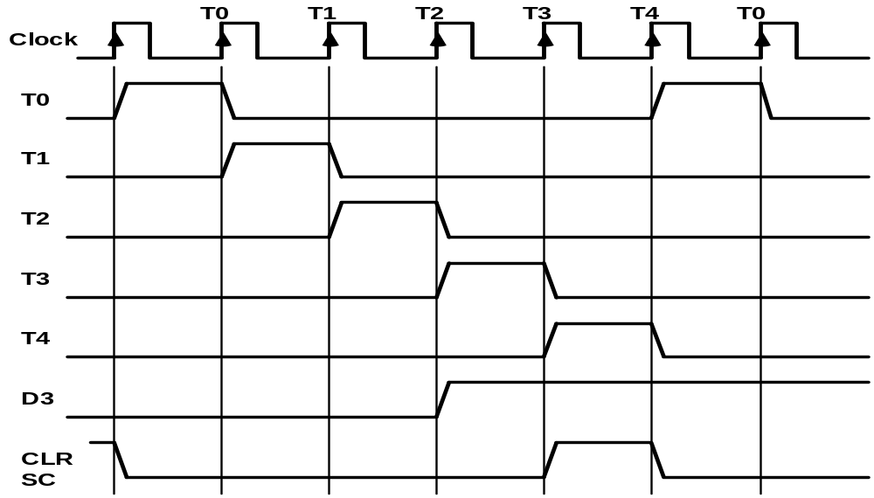
Basic Computer Orgsnization and Design <number>
Timing Signals
- Generated by 4-bit sequence counter and 4×16 decoder
- The SC can be incremented or cleared.
- Example: T₀, T₁, T₂, T₃, T₄, T₀, T₁, . . .
Assume: At time T₄, SC is cleared to 0 if decoder output D3 is active.
D₃T₄: SC ← 0
CSE 211

Slide 25
Basic Computer Orgsnization and Design <number>
Instruction Cycle
In Basic Computer, a machine instruction is executed in the following cycle:
  Fetch an instruction from memory
  Decode the instruction
  Read the effective address from memory if the instruction has an indirect address
  Execute the instruction
After an instruction is executed, the cycle starts again at step 1, for the next instruction
Note: Every different processor has its own (different) instruction cycle
CSE 211

Slide 26
Basic Computer Organization and Design <number>
Fetch and Decode
Initially PC loaded with address of first instruction and Sequence counter cleared to 0, giving timing signal T0
T0: AR ←PC
T1: IR ← M [AR], PC ← PC + 1
T2: D0, . . . , D7 ← Decode IR(12-14), AR ← IR(0-11), I ← IR(15)
CSE 211

Slide 27
Basic Computer Organization and Design <number>
Fetch and Decode
Fetch and Decode
T0: AR ← PC (S₀S₁S₂=010, T0=1)
T1: IR ← M [AR], PC ← PC + 1 (S0S1S2=111, T1=1)
T2: D0, . . . , D7 ← Decode IR(12-14), AR ← IR(0-11), I ← IR(15)
T1
S₂
T0
S₁
Bus
S₀
Memory
7
unit
Address
Read
AR
1
LD
PC
2
INR
IR
5
LD
Clock
Common bus
CSE 211

Slide 28
Basic Computer Organization and Design <number>
Fetch and Decode
Figure shows how first two statements are implemented in bus system
At T0 :
    1. Place the content of PC into bus by making S2S1S0=010
    Transfer the content of bus to AR by enabling the LD input of AR
At T1 :
    1. Enable read input of memory
    2. Place content of bus by making S2S1S0=111
    3. Transfer content of bus to IR by enabling the LD input of IR
    4. Increment PC by enabling the INR input of PC
CSE 211

Slide 29
Basic Computer Organization and Design <number>
Determine the Type of Instructions
Start
SC <-- 0
AR
<--
PC
T0
T1
IR
<--
M[AR],
PC
<--
PC + 1
T2
Decode Opcode in IR(12-14),
AR
<--
IR(0-11),
<--
I
IR(15)
(Register or I/O) = 1
D7
= 0 (Memory-reference)
(I/O) = 1
= 0 (register)
(indirect) = 1
= 0 (direct)
I
I
T3
T3
T3
T3
Execute
Execute
AR
<--
M[AR]
Nothing
input-output
register-reference
instruction
instruction
SC
<--
0
SC
<--
0
Execute
T4
memory-reference
instruction
SC
<--
0
Fig : Flow chart for Instruction Cycle
CSE 211

Slide 30
Basic Computer Organization and Design <number>
Determining Type of Instruction
D'7IT3: AR ← M[AR]
D'7I'T3: Nothing
D7I'T3: Execute a register-reference instr.
D7IT3: Execute an input-output instr.
CSE 211

Slide 31
Basic Computer Organization and Design <number>
Register Reference Instruction
Register Reference Instructions are identified when
- D₇ = 1, I = 0
- Register Ref. Instr. is specified in b₀ ~ b₁₁ of IR
- Execution starts with timing signal T₃
r = D₇ I′T₃ => Register Reference Instruction
B_{i} = IR(i) , i=0,1,2,...,11
e.g. rB11=CLA
r: SC ← 0
CLA rB₁₁: AC ← 0
CLE rB₁₀: E ← 0
CMA rB₉: AC ← AC’
CME rB₈: E ← E’
CIR rB₇: AC ← shr AC, AC(15) ← E, E ← AC(0)
CIL rB₆: AC ← shl AC, AC(0) ← E, E ← AC(15)
INC rB₅: AC ← AC + 1
SPA rB₄: if (AC(15) = 0) then (PC ← PC+1)
SNA rB₃: if (AC(15) = 1) then (PC ← PC+1)
SZA rB₂: if (AC = 0) then (PC ← PC+1)
SZE rB₁: if (E = 0) then (PC ← PC+1)
HLT rB₀: S ← 0 (S is a start-stop flip-flop)
CSE 211

Slide 32
Basic Computer Organization and Design <number>
Memory Reference Instructions
Symbol
Operation
Decoder
Symbolic Description
AND D₀ AC ← AC ∧ M[AR]
ADD D₁ AC ← AC + M[AR], E ← C_{out}
LDA D₂ AC ← M[AR]
STA D₃ M[AR] ← AC
BUN D₄ PC ← AR
BSA D₅ M[AR] ← PC, PC ← AR + 1
ISZ D₆ M[AR] ← M[AR] + 1, if M[AR] + 1 = 0 then PC ← PC+1
- The effective address of the instruction is in AR and was placed there during
timing signal T₂ when I = 0, or during timing signal T₃ when I = 1
- Memory cycle is assumed to be short enough to complete in a CPU cycle
- The execution of MR instruction starts with T₄
AND to AC //performs AND logic with AC and memory word specified by EA
D₀T₄: DR ← M[AR] Read operand
D₀T₅: AC ← AC ∧ DR, SC ← 0 AND with AC
CSE 211

Slide 33
Basic Computer Organization and Design <number>
Memory Reference Instructions
ADD to AC // add content of memory word specified by EA to value of AC
sum is transferred to AC and Carry to E (Extended Accumulator)
D₁T₄: DR ← M[AR] Read operand
D₁T₅: AC ← AC + DR, E ← C_{out}, SC ← 0 Add to AC and store carry in E
LDA: Load to AC // Transfers memory word specified by memory address to AC
D₂T₄: DR ← M[AR]
D₂T₅: AC ← DR, SC ← 0
STA: Store AC // Stores the content of AC into memory specified by EA
D₃T₄: M[AR] ← AC, SC ← 0
BUN: Branch Unconditionally // Transfer program to instruction specified by EA
D₄T₄: PC ← AR, SC ← 0
CSE 211

Slide 34
Basic Computer Organization and Design <number>
Memory Reference Instructions
BSA: Branch and Save Return Address // 1. stores address of next instruction in sequence (PC) into address specified by EA 2. EA+1 transfer to PC serve as 1st inst. In subroutine
M[AR] ← PC, PC ← AR + 1
BSA:
D₅T₄: M[AR] ← PC, AR ← AR + 1
D₅T₅: PC ← AR, SC ← 0
BSA: Example
M[135] ← 21, PC ← 135 + 1=136
Memory, PC, AR at time T4
Memory, PC after execution
20
0
BSA
135
20
0
BSA
135
PC = 21
Next instruction
21
Next instruction
AR = 135
135
21
136
Subroutine
PC = 136
Subroutine
1
BUN
135
1
BUN
135
CSE 211

Slide 35
Basic Computer Organization and Design <number>
Memory Reference Instructions
ISZ: Increment and Skip-if-Zero
// increments the word specified by effective address,
and if incremented value=0 , PC incremented by 1
D₆T₄: DR ← M[AR]
D₆T₅: DR ← DR + 1
D₆T₄: M[AR] ← DR, if (DR = 0) then (PC ← PC + 1), SC ← 0
CSE 211

Slide 36
Basic Computer Organization and Design <number>
Flow Chart - Memory Reference Instructions
Memory-reference instruction
AND
ADD
LDA
STA
D T
4
D T
D T
D T
0
1
4
2
4
3
4
DR ← M[AR]
DR ← M[AR]
DR ← M[AR]
M[AR] ← AC
SC ← 0
D T
D T
D T
0
5
1
5
2
5

AC ← AC DR
AC ← AC + DR
AC ← DR
SC ← 0
E ← Cout
SC ← 0
SC ← 0
BUN
BSA
ISZ
D T
D T
D T
4
4
5
4
6
4
PC ← AR
M[AR] ← PC
DR ← M[AR]
SC ← 0
AR ← AR + 1
D T
D T
5
5
6
5
PC ← AR
DR ← DR + 1
SC ← 0
D T
6
6
M[AR] ← DR
If (DR = 0)
then (PC ← PC + 1)
SC ← 0
CSE 211

Slide 37
Basic Computer Organization and Design <number>
Input/Output and Interrupt
A Terminal with a keyboard and a Printer
Input-Output Configuration
Input-output
Serial
Computer
registers and
flip-flops
terminal
communication
interface
Printer
Receiver
OUTR
FGO
interface
AC
Keyboard
Transmitter
INPR
FGI
INPR Input register - 8 bits
OUTR Output register - 8 bits
FGI Input flag - 1 bit
FGO Output flag - 1 bit
IEN Interrupt enable - 1 bit
interface
Serial Communications Path
Parallel Communications Path
- The terminal sends and receives serial information
- The serial info. from the keyboard is shifted into INPR
- The serial info. for the printer is stored in the OUTR
- INPR and OUTR communicate with the communication interface serially and with the AC in parallel.
- The flags are needed to synchronize the timing difference between I/O device and the computer
CSE 211

Slide 38
Basic Computer Organization and Design <number>
Determining Type of Instruction
FGI =1 when new information available at input device,
and cleared to 0 when information accepted by
computer
Initially FGI=0, new key pressed , 8 bit alphanumeric
shifted to INPR and FGI=1, Computer checks flag if 1
then transfer content to AC and clear FGI to 0.
Initially FGO=1,
- computer checks flag bit if 1, then OUTR ← AC and
clears FGO=0
- O/P device accepts information prints character and
finally sets FGO=1.
CSE 211

Slide 39
Basic Computer Orgsnisation and Design <number>
Input/Output Instructions
I/O instructions are needed for transferring info to and from AC register, for checking the flag bits and for controlling interrupt facility
D₇IT₃ = p
IR(i) = B_{i}, i = 6, …, 11
p: SC ← 0 Clear SC
INP pB₁₁: AC(0-7) ← INPR, FGI ← 0 Input char. to AC
OUT pB₁₀: OUTR ← AC(0-7), FGO ← 0 Output char. from AC
SKI pB₉: if(FGI = 1) then (PC ← PC + 1) Skip on input flag
SKO pB₈: if(FGO = 1) then (PC ← PC + 1) Skip on output flag
ION pB₇: IEN ← 1 Interrupt enable on
IOF pB₆: IEN ← 0 Interrupt enable off
CSE 211

Slide 40
Basic Computer Organization and Design <number>
Program controlled Input/Output
Program-controlled I/O
Continuous CPU involvement
CPU keeps checking flag bit. If 1 then initiates transfer
I/O takes valuable CPU time
Difference in information flow rate makes this type of
transfer inefficient
Alternative approach is to let external device inform the computer when
it is ready for transfer, in meantime computer can be busy with other task
- Interrupt
CSE 211

Slide 41
Basic Computer Organization and Design <number>
Interrupt Initiated Input/Output
- Open communication only when some data has to be passed --> interrupt.
- The I/O interface, instead of the CPU, monitors the I/O device.
- When the interface founds that the I/O device is ready for data transfer,
it generates an interrupt request to the CPU
- Upon detecting an interrupt, the CPU stops momentarily the task
it is doing, branches to the service routine to process the data
transfer, and then returns to the task it was performing.
IEN (Interrupt-enable flip-flop)
- can be set and cleared by instructions
  When cleared (IEN=0) the computer cannot be interrupted
  When set (IEN=1) the computer can be interrupted
CSE 211

Slide 42
Basic Computer Organization and Design <number>
Flow Chart of Interrupt Cycle
R = Interrupt f/f
Instruction cycle
=0
R
=1
Interrupt cycle
Fetch and decode
Store return address
INPR Input register - 8 bits
OUTR Output register - 8 bits
FGI Input flag - 1 bit
FGO Output flag - 1 bit
IEN Interrupt enable - 1 bit
instructions
in location 0
M[0] ← PC
Execute
IEN
=0
instructions
=1
Branch to location 1
=1
PC ← 1
FGI
=0
=1
FGO
IEN ← 0
R ← 0
=0
R ← 1
- The interrupt cycle is a HW implementation of a branch and save return address operation.
- At the beginning of the next instruction cycle, the instruction that is read from memory is in address 1.
- At memory address 1, the programmer must store a branch instruction that sends the control to an interrupt service routine
- The instruction that returns the control to the original program is "indirect BUN 0"
CSE 211

Slide 43
Basic Computer Orgsnization and Design <number>
Register Transfer Operations in Interrupt Cycle
Memory
Before interrupt
After interrupt cycle
0
0
256
1
0
BUN
1120
PC = 1
0
BUN
1120
255
Main
Main
PC = 256
Program
255
Program
256
1120
1120
I/O
I/O
Program
Program
1
BUN
0
1
BUN
0
Register Transfer Statements for Interrupt Cycle
- R F/F ← 1 if IEN (FGI + FGO)T₀′T₁′T₂′
⇔ T₀′T₁′T₂′ (IEN)(FGI + FGO): R ← 1
- The fetch and decode phases of the instruction cycle
must be modified ➔Replace T₀, T₁, T₂ with R'T₀, R'T₁, R'T₂
- The interrupt cycle :
RT₀: AR ← 0, TR ← PC
RT₁: M[AR] ← TR, PC ← 0
RT₂: PC ← PC + 1, IEN ← 0, R ← 0, SC ← 0
CSE 211

Slide 44
Basic Computer Organization and Design <number>
Complete Computer Description
start
SC ← 0, IEN ← 0, R ← 0
=0(Instruction =1(Interrupt
Cycle) Cycle)
R
R’T₀
RT₀
AR ← PC
R’T₁
AR ← 0, TR ← PC
RT₁
IR ← M[AR], PC ← PC + 1
M[AR] ← TR, PC ← 0
R’T₂
RT₂
AR ← IR(0~11), I ← IR(15)
D₀...D₇ ← Decode IR(12 ~ 14)
PC ← PC + 1, IEN ← 0
R ← 0, SC ← 0
=1(Register or I/O) =0(Memory Ref)
INPR Input register - 8 bits
OUTR Output register - 8 bits
FGI Input flag - 1 bit
FGO Output flag - 1 bit
IEN Interrupt enable - 1 bit
D₇
=1 (I/O) =0 (Register) =1(Indir) =0(Dir)
I
I
D₇IT₃ D₇I’T₃
D₇’IT3 D₇’I’T3
Execute
I/O
Instruction
Execute
RR
Instruction
AR <- M[AR]
Idle
Execute MR
Instruction
D₇’T4
CSE 211

Slide 45
Basic Computer Organization and Design <number>
Complete Computer Design
Fetch
Decode
Indirect
Interrupt
Memory-Reference
AND
ADD
LDA
STA
BUN
BSA
ISZ
R′T₀:
R′T₁:
R′T₂:
D₇′IT₃:
RT₀:
RT₁:
RT₂:
D₀T₄:
D₀T₅:
D₁T₄:
D₁T₅:
D₂T₄:
D₂T₅:
D₃T₄:
D₄T₄:
D₅T₄:
D₅T₅:
D₆T₄:
D₆T₅:
D₆T₆:
AR ← PC
IR ← M[AR], PC ← PC + 1
D0, ..., D7 ← Decode IR(12 ~ 14),
AR ← IR(0 ~ 11), I ← IR(15)
AR ← M[AR]
R ← 1
AR ← 0, TR ← PC
M[AR] ← TR, PC ← 0
PC ← PC + 1, IEN ← 0, R ← 0, SC ← 0
DR ← M[AR]
AC ← AC ∧ DR, SC ← 0
DR ← M[AR]
AC ← AC + DR, E ← C_{out}, SC ← 0
DR ← M[AR]
AC ← DR, SC ← 0
M[AR] ← AC, SC ← 0
PC ← AR, SC ← 0
M[AR] ← PC, AR ← AR + 1
PC ← AR, SC ← 0
DR ← M[AR]
DR ← DR + 1
M[AR] ← DR, if(DR=0) then (PC ← PC + 1),
SC ← 0
CSE 211

Slide 46
Basic Computer Organization and Design <number>
Complete Computer Design
Register-Reference
CLA
CLE
CMA
CME
CIR
CIL
INC
SPA
SNA
SZA
SZE
HLT
Input-Output
INP
OUT
SKI
SKO
ION
IOF
D₇I′T₃ = r
IR(i) = B_{i}
r:
rB₁₁:
rB₁₀:
rB₉:
rB₈:
rB₇:
rB₆:
rB₅:
rB₄:
rB₃:
rB₂:
rB₁:
rB₀:
D₇IT₃ = p
IR(i) = B_{i}
p:
pB₁₁:
pB₁₀:
pB₉:
pB₈:
pB₇:
pB₆:
(Common to all register-reference instr)
(i = 0,1,2, ..., 11)
SC ← 0
AC ← 0
E ← 0
AC ← AC′
E ← E′
AC ← shr AC, AC(15) ← E, E ← AC(0)
AC ← shl AC, AC(0) ← E, E ← AC(15)
AC ← AC + 1
If(AC(15) =0) then (PC ← PC + 1)
If(AC(15) =1) then (PC ← PC + 1)
If(AC = 0) then (PC ← PC + 1)
If(E=0) then (PC ← PC + 1)
S ← 0
(Common to all input-output instructions)
(i = 6,7,8,9,10,11)
SC ← 0
AC(0-7) ← INPR, FGI ← 0
OUTR ← AC(0-7), FGO ← 0
If(FGI=1) then (PC ← PC + 1)
If(FGO=1) then (PC ← PC + 1)
IEN ← 1
IEN ← 0
CSE 211

Slide 47
Basic Computer Organization and Design <number>
Design of a Basic Computer(BC)
Hardware Components of BC
A memory unit: 4096 x 16.
Registers:
AR, PC, DR, AC, IR, TR, OUTR, INPR, and SC
Flip-Flops(Status):
I, E, R, IEN, FGI, and FGO
Decoders: a 3x8 Opcode decoder
a 4x16 timing decoder
Common bus: 16 bits
Control logic gates:
Adder and Logic circuit: Connected to AC
Control Logic Gates
  - Input Controls of the nine registers
  - Read and Write Controls of memory
  - Set, Clear, or Complement Controls of the flip-flops
  - S₂, S₁, S₀ Controls to select a register for the bus
  - AC, and Adder and Logic circuit
CSE 211

Slide 48
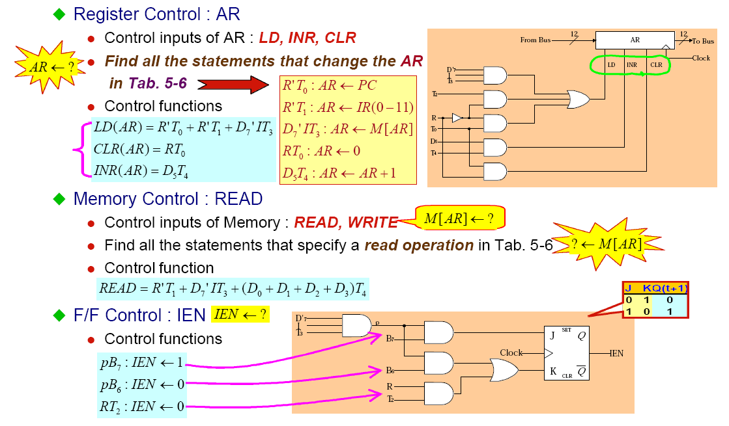
Basic Computer Organization and Design <number>
Design of a Basic Computer(BC)
CSE 211

Slide 49
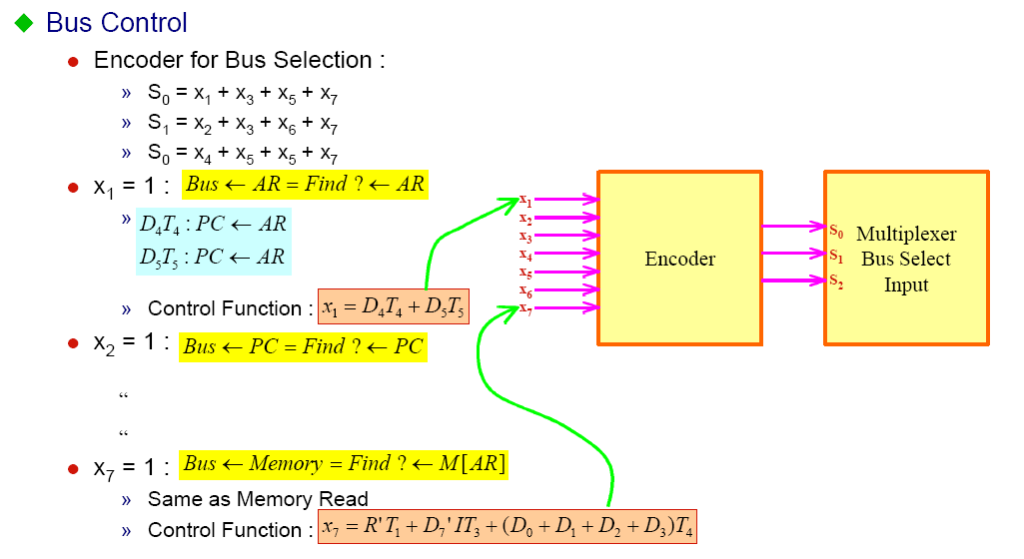
Basic Computer Organization and Design <number>
Design of a Basic Computer(BC)
CSE 211

